Slide 1


Slide 2
[02]
Real World Data at scale

Slide 3

Healthcare and Lifesciences have long had an uneven data Demand/Supply relationship^{[1]}.
[02] Real World Data at Scale
SUPPLY
Hospitals are only able to supply small samples or inconsistently collected.
DEMAND
Need large datasets, collected in the least possible time and with the minimum possible effort.
[1]: Grimberg F, Asprion PM, Schneider B, Miho E, Babrak L, Habbabeh A. The Real-World Data Challenges Radar: A Review on the Challenges and Risks regarding the Use of Real-World Data. Digit Biomark. 2021 Jun 24;5(2):148-157. doi: 10.1159/000516178. PMID: 34414352; PMCID: PMC8339486.

Slide 4
The root of the Market Gap lies in Real World Data [RWD] supply.
[01] Real World Data at Scale
UNSTRUCTURED INFORMATION
65−85% of patients’ clinically relevant information stored in hospitals is in unstructured format.
2.3
SILOED INFORMATION
Data is still disperse and mostly accessible by only hospital by hospital.
EXABYTES
of Real World Data in healthcare are not fully leveraged.
Zhao X et al. Integrating real-world data to accelerate and guide drug development: A clinical pharmacology perspective. Clin Transl Sci. 2022 Oct;15 (10):2293−2302.

Slide 5




Access Challenges
[01] Real World Data at Scale
Scalability & Data Integration
Handling large volumes of data and merging information from multiple sources and formats demands the right data infrastructure and resources.
Interpretation & Standardization
The complexity and sheer volume of data can make its interpretation and application in clinical practice challenging.
Data Quality
The variability and lack of standardization can impact the utility of Real-World Data.
Privacy & Security
The secure management of sensitive data is an ongoing challenge.

Slide 6
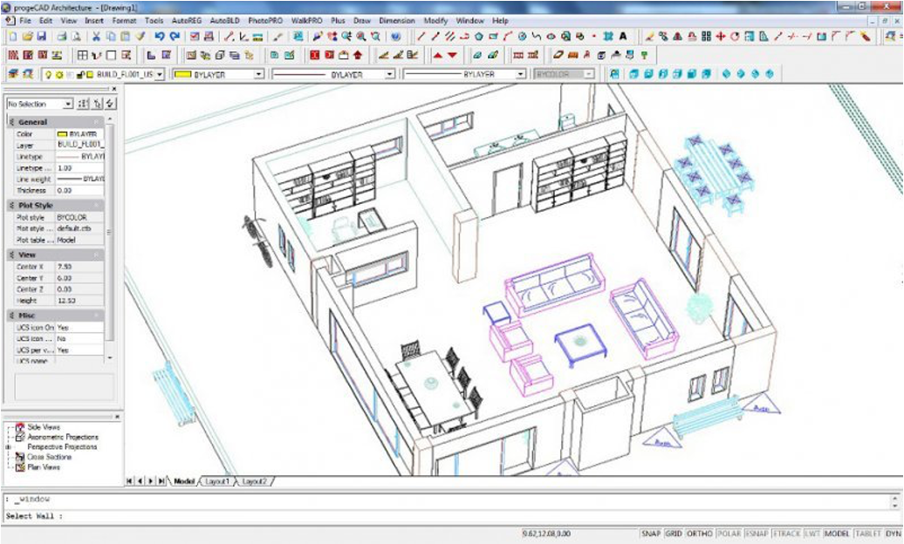
How to represent a patient’s data?
[01] Real World Data at Scale
Data Origin:
Current data acquisition has been carried out for process digitalization.
Patient Representation:
There is still no true digitalization that completely represents a patient.
We need an approach to data where the data is patient-centric and not process-centric.

Slide 7




Patient-centric approach
[01] Real World Data at Scale
Digitization of health data has been process-centric, making data messy, sparse and inaccessible.
AI
Legacy Healthcare Data Architecture
Patient-centric Data Architecture

Slide 8
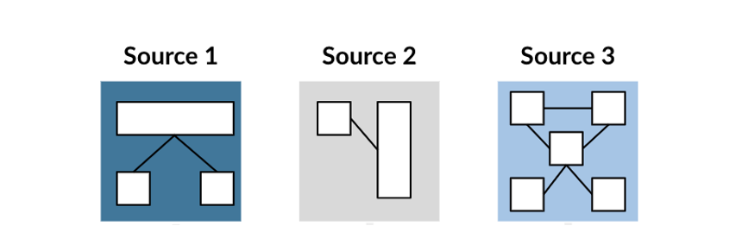
Common data sources in the clinical environment
[01] Real World Data at Scale
Clinical history:
Primary source of clinical data, but often unstructured.
Medical devices (Gastroscopies, ECG... ):
Generates real-time data in environments such as the ICU, operating room, home, radiology...
Laboratory Data:
Complementary data derived from tests on samples...
Hospital Dispensing:
Data on medications and treatments administered in the hospital or primary care setting.
[…]

Slide 9
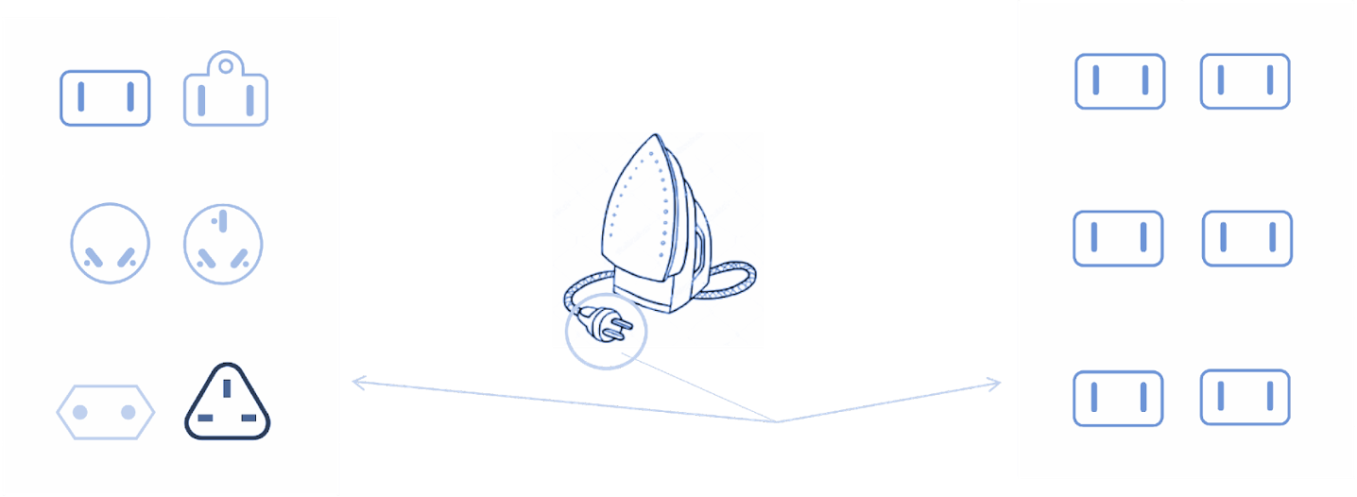
The data is heterogeneous by nature.
[01] Real World Data at Scale
The data require a normalization process in order to derive value from them at scale. It is not feasible to adjust the data for each individual system or use case.
Use case
e.g. Observational Study
Data Sources
Standard Format
e.g. different hospitals and information systems

Slide 10
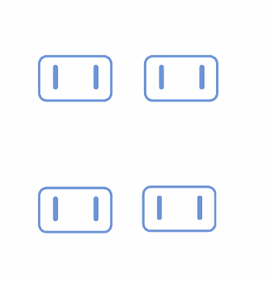
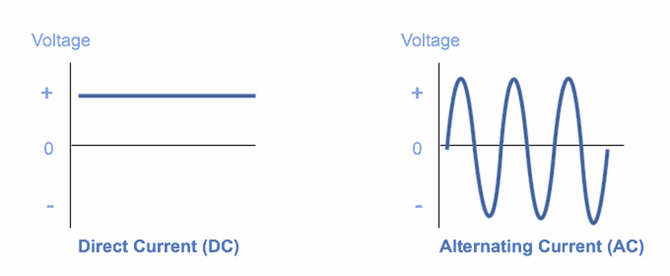
The data is heterogeneous by nature.
[01] Real World Data at Scale
Providing a common data model is only half the job. The data stored must also represent the same meaning.
Same structure
Same vocabulary
e.g. The same type of plug.
e.g. The same electrical current.

Slide 11
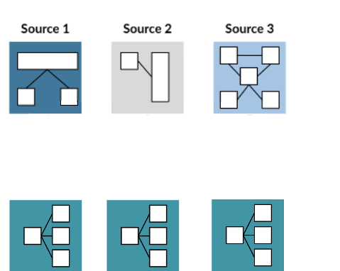
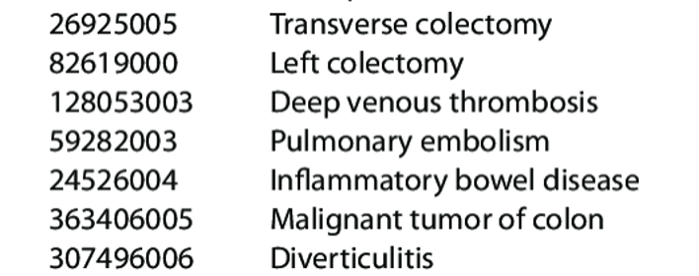
The data is heterogeneous by nature.
[01] Real World Data at Scale
Providing a common data model is only half the job. The data stored must also represent the same meaning.
Same structure
Same vocabulary
e.g. The same type of plug.
e.g. The same electrical current.

Slide 12
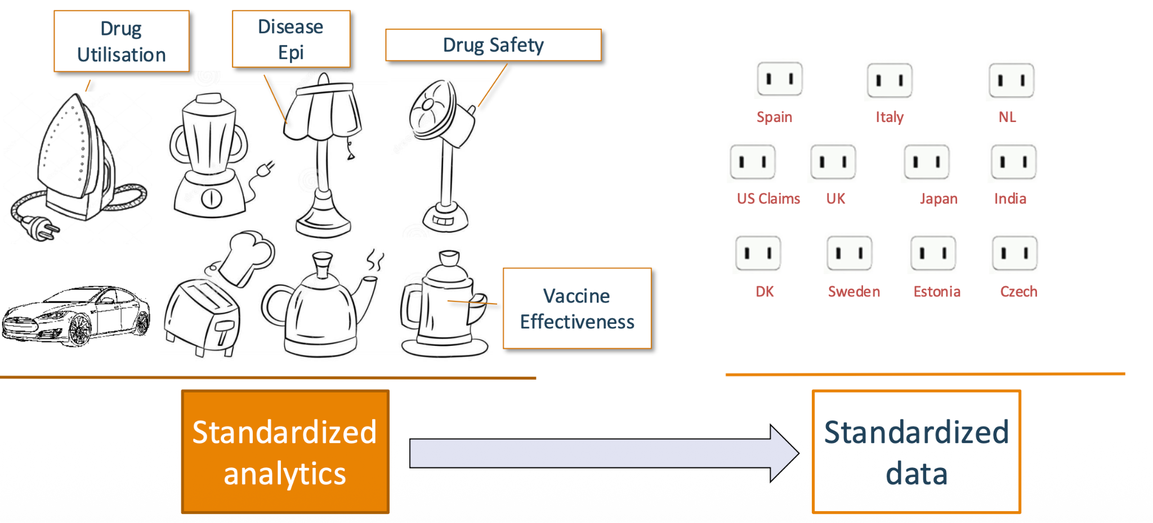
The data is heterogeneous by nature.
[01] Real World Data at Scale

Slide 13
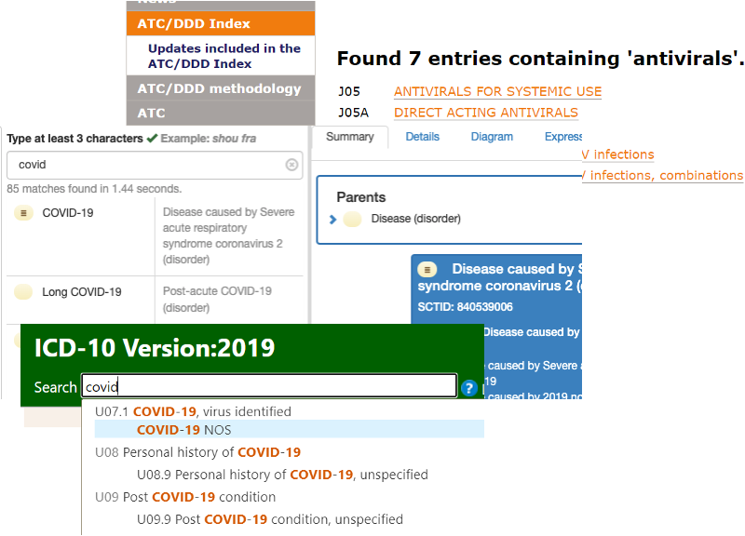
The data is heterogeneous by nature.
[01] Real World Data at Scale
Standard Structure, Format, and Content:
The importance of standardized tables, variables, and codes for applying uniform analytical methods.
E.G.
ICD Codes:
A global standard for diagnoses and health conditions.
SNOMED CT:
Used to encode medical terms and ensure a common language in healthcare.
LOINC:
Used to identify tests, measurements, and observations.
[…]

Slide 14
How do we achieve a common data language?
[01] Real World Data at Scale
Common Data Models (CDMs) for observational research:
Observational Medical Outcomes Partnership (OMOP)
Mini – Sentinel (FDA)
ConcePTION (IMI)
Common data models also exist for data capture in interventional studies:
Study Data Tabulation Model (SDTM)

Slide 15
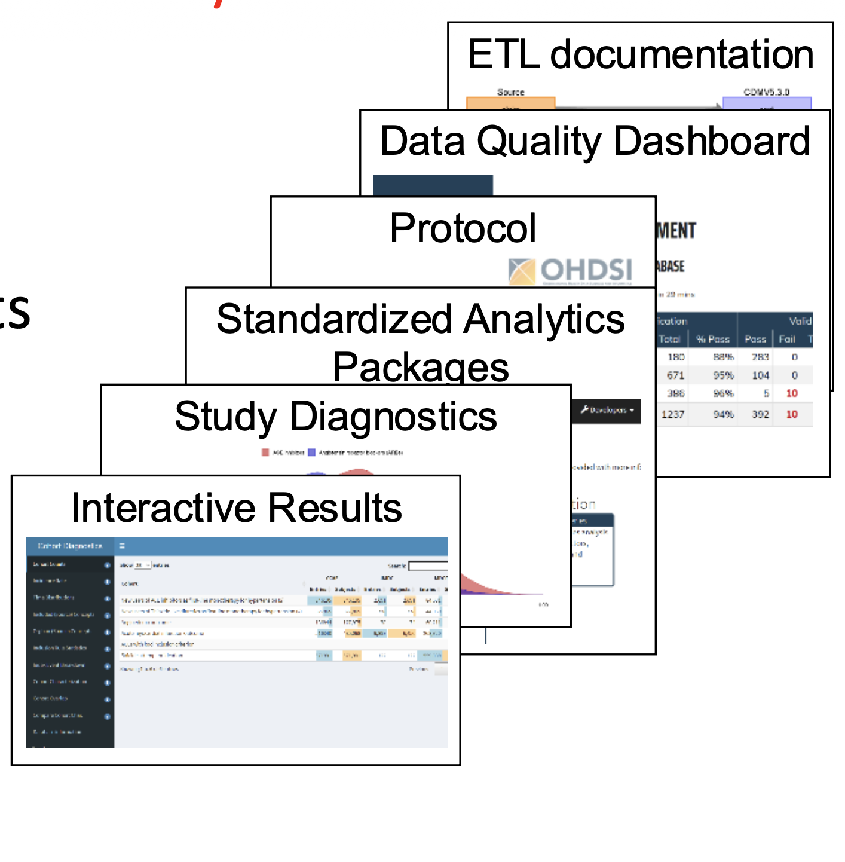
The end goal is Open Science at scale
[01] Real World Data at Scale
We MUST NOT do ‘silo’ Health Data Science
We need to declare a protocol
We need to share ALL our code
We need to share ALL our results
Transparency is key to:
Reproducibility
Interpretability
Trustworthiness

Slide 16
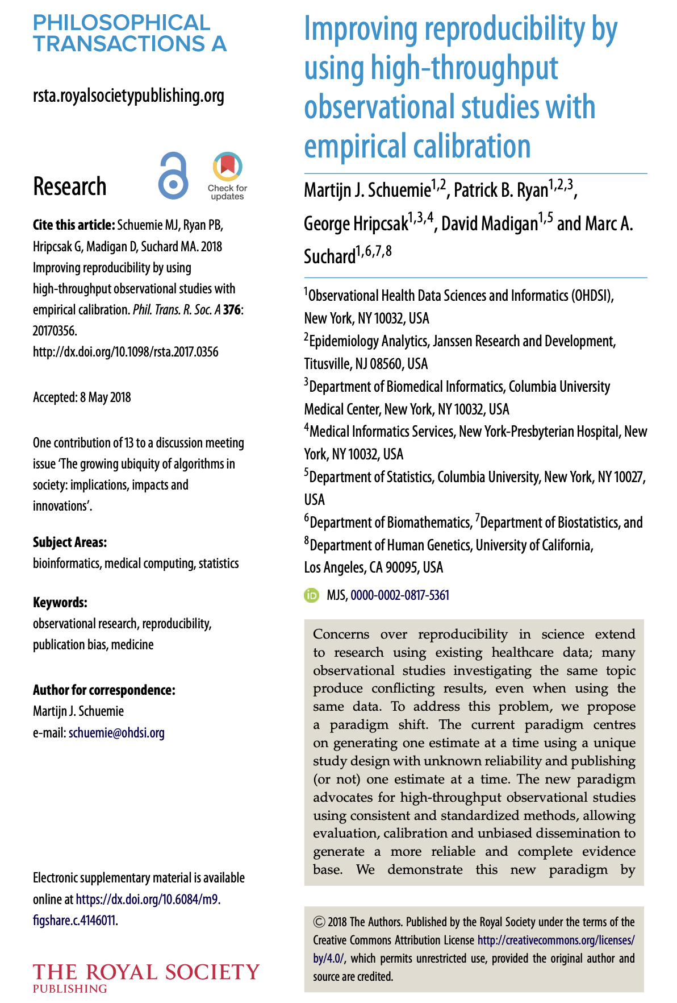
The end goal is Open Science at scale
[01] Real World Data at Scale
Issues with clinical research:
Reproducibility crisis
Lack of trust in real-world evidence
Major issues:
Observational study bias (e.g. confounding)
Publication bias
P-hacking

Slide 17
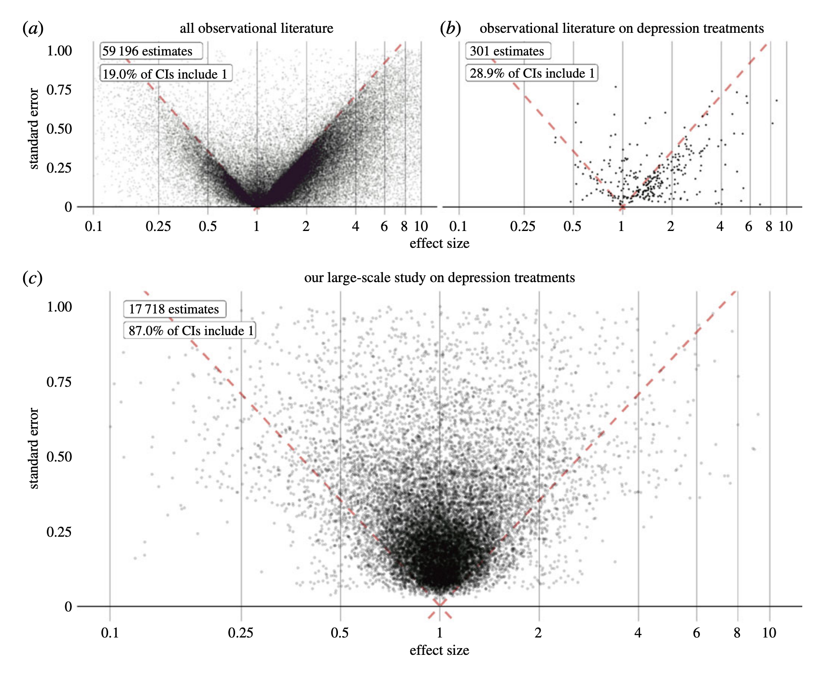
The end goal is Open Science at scale
[01] Real World Data at Scale

Slide 18
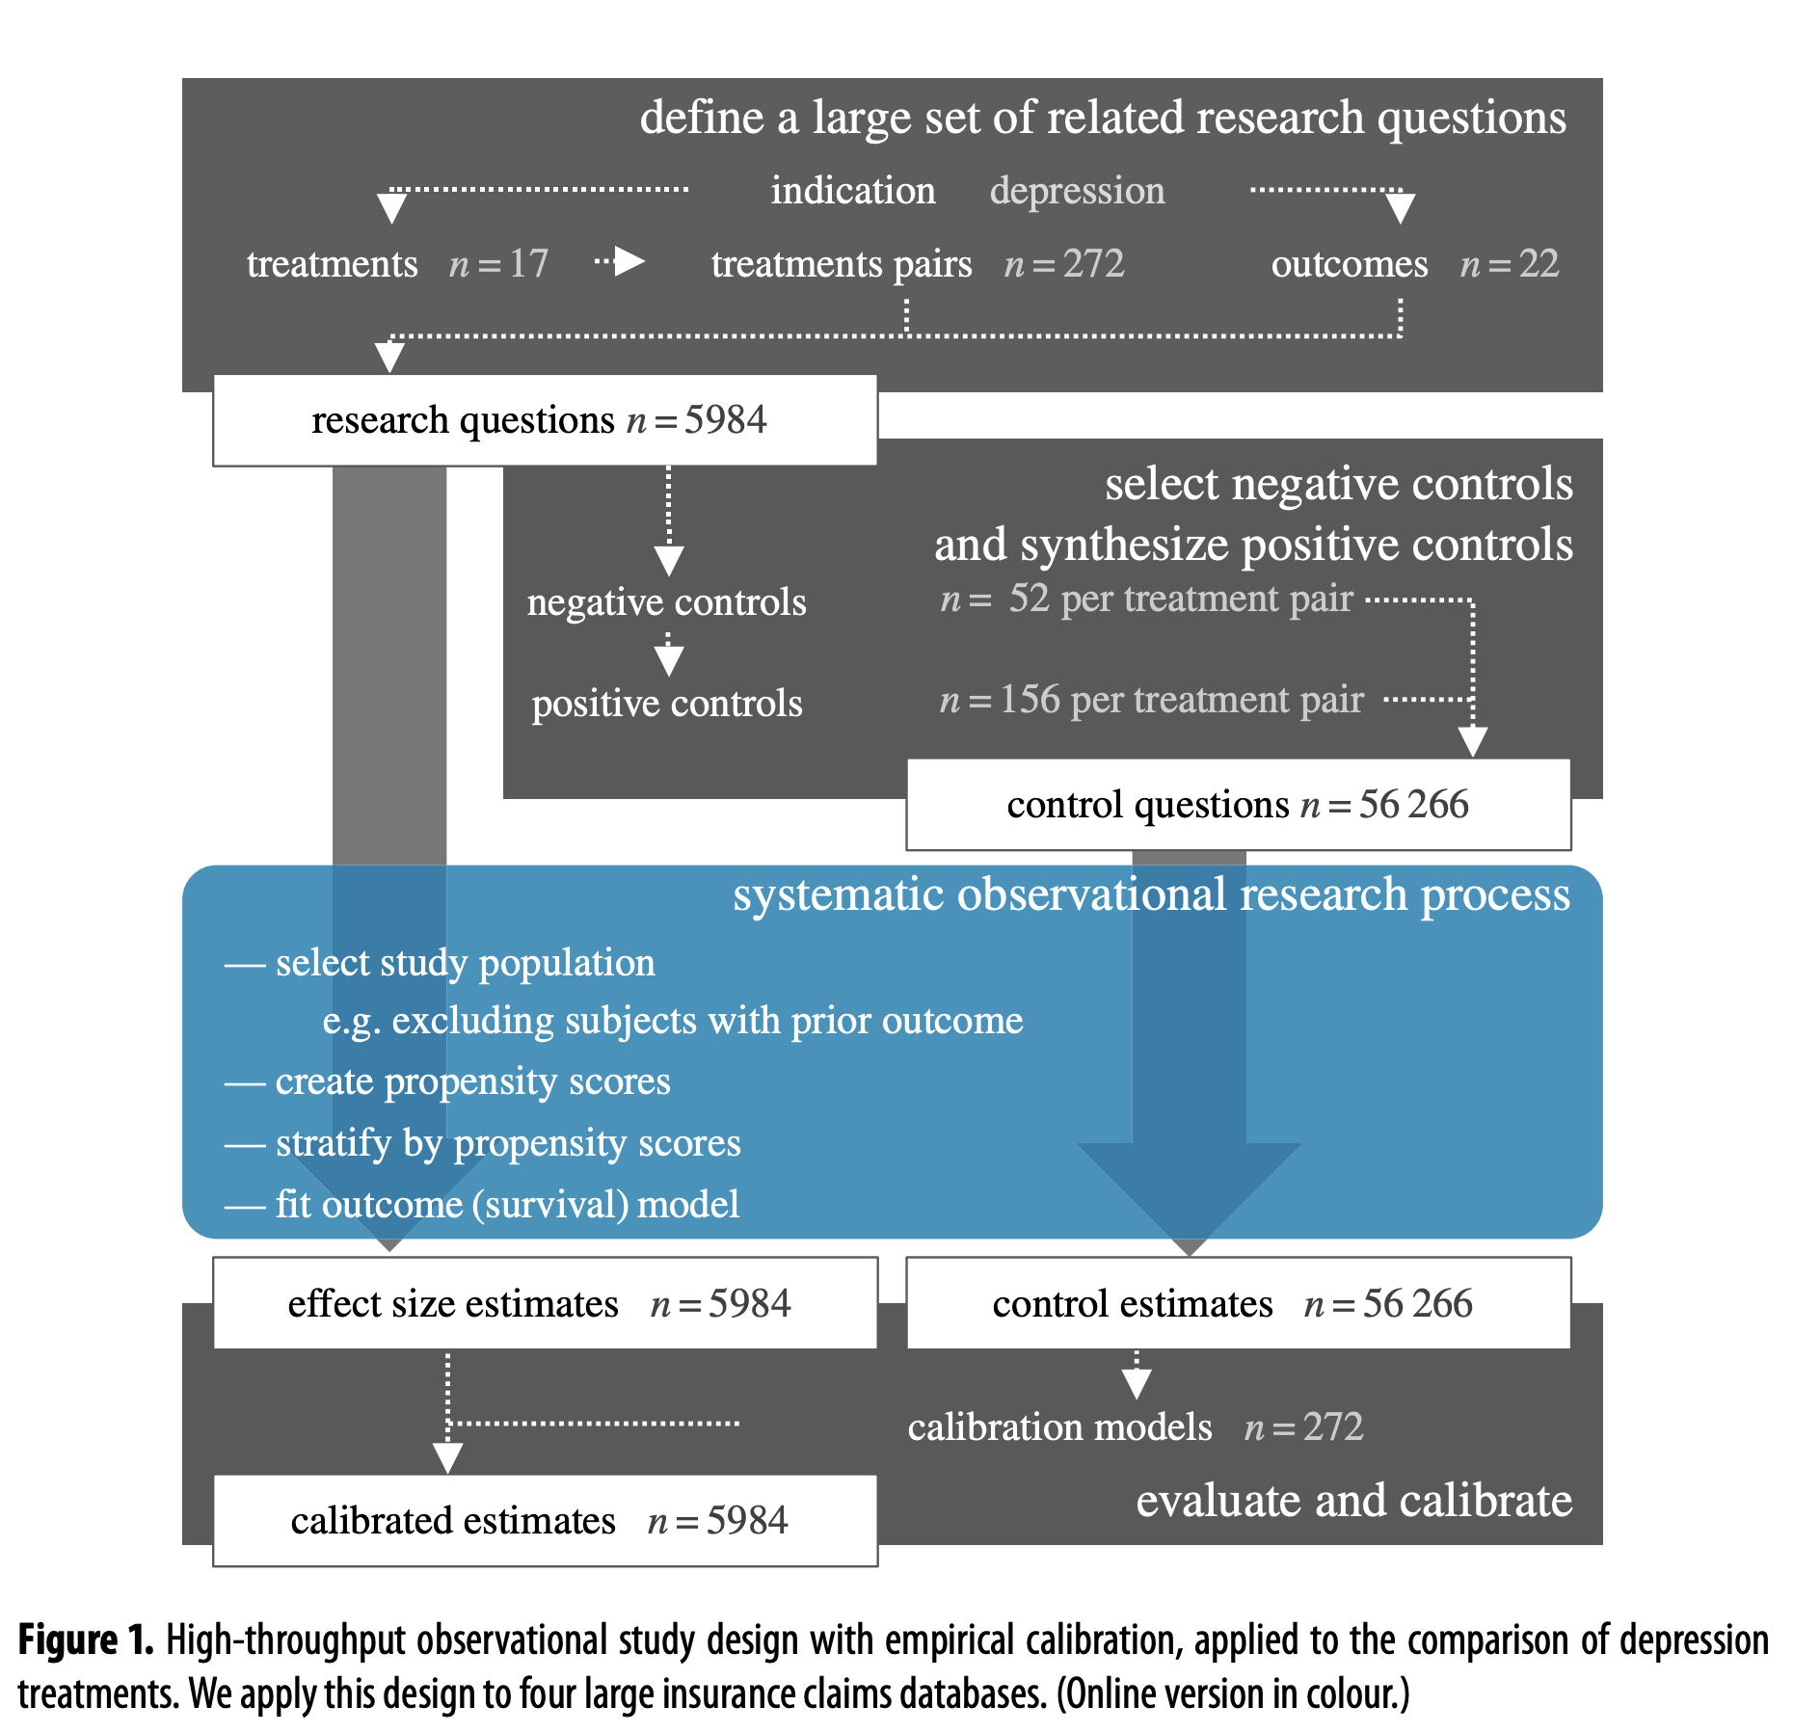
A new paradigm in clinical research
[01] Real World Data at Scale

Slide 19
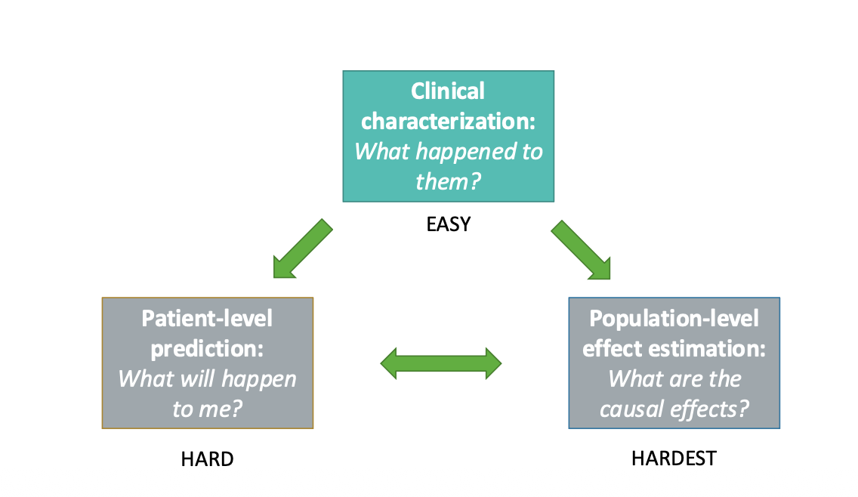
Impactful examples
[01] Real World Data at Scale

Slide 20
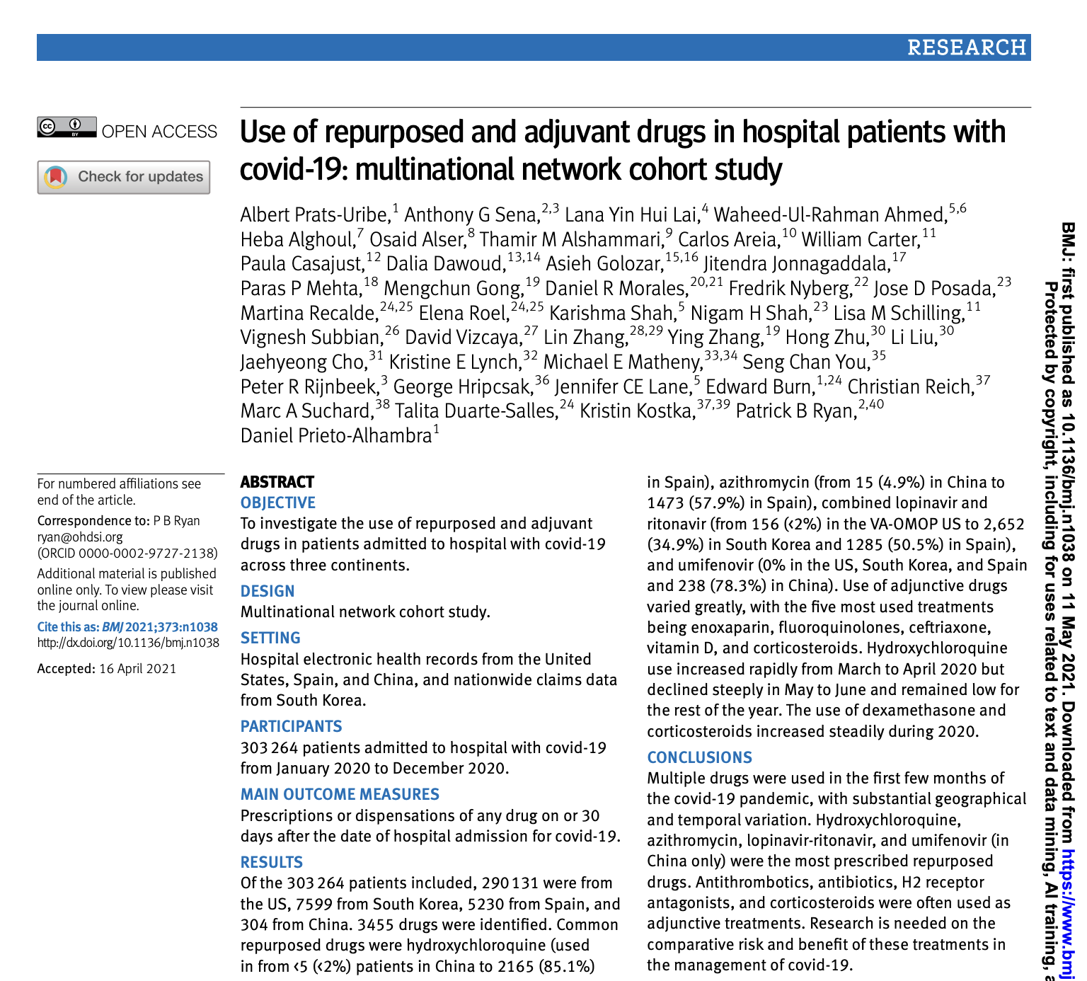
Impactful examples: Clinical characterization
[01] Real World Data at Scale
During first COVID19 months
We needed to understand the pathology
We needed to evaluate the efficacy and effectiveness at scale and fast
Huge community effort to execute these studies
BEFORE the clinical trials!!
Prats-Uribe A, Sena A G, Lai L Y H, Ahmed W, Alghoul H, Alser O et al. Use of repurposed and adjuvant drugs in hospital patients with covid-19: multinational network cohort study BMJ 2021; 373 :n1038 doi:10.1136/bmj.n1038

Slide 21
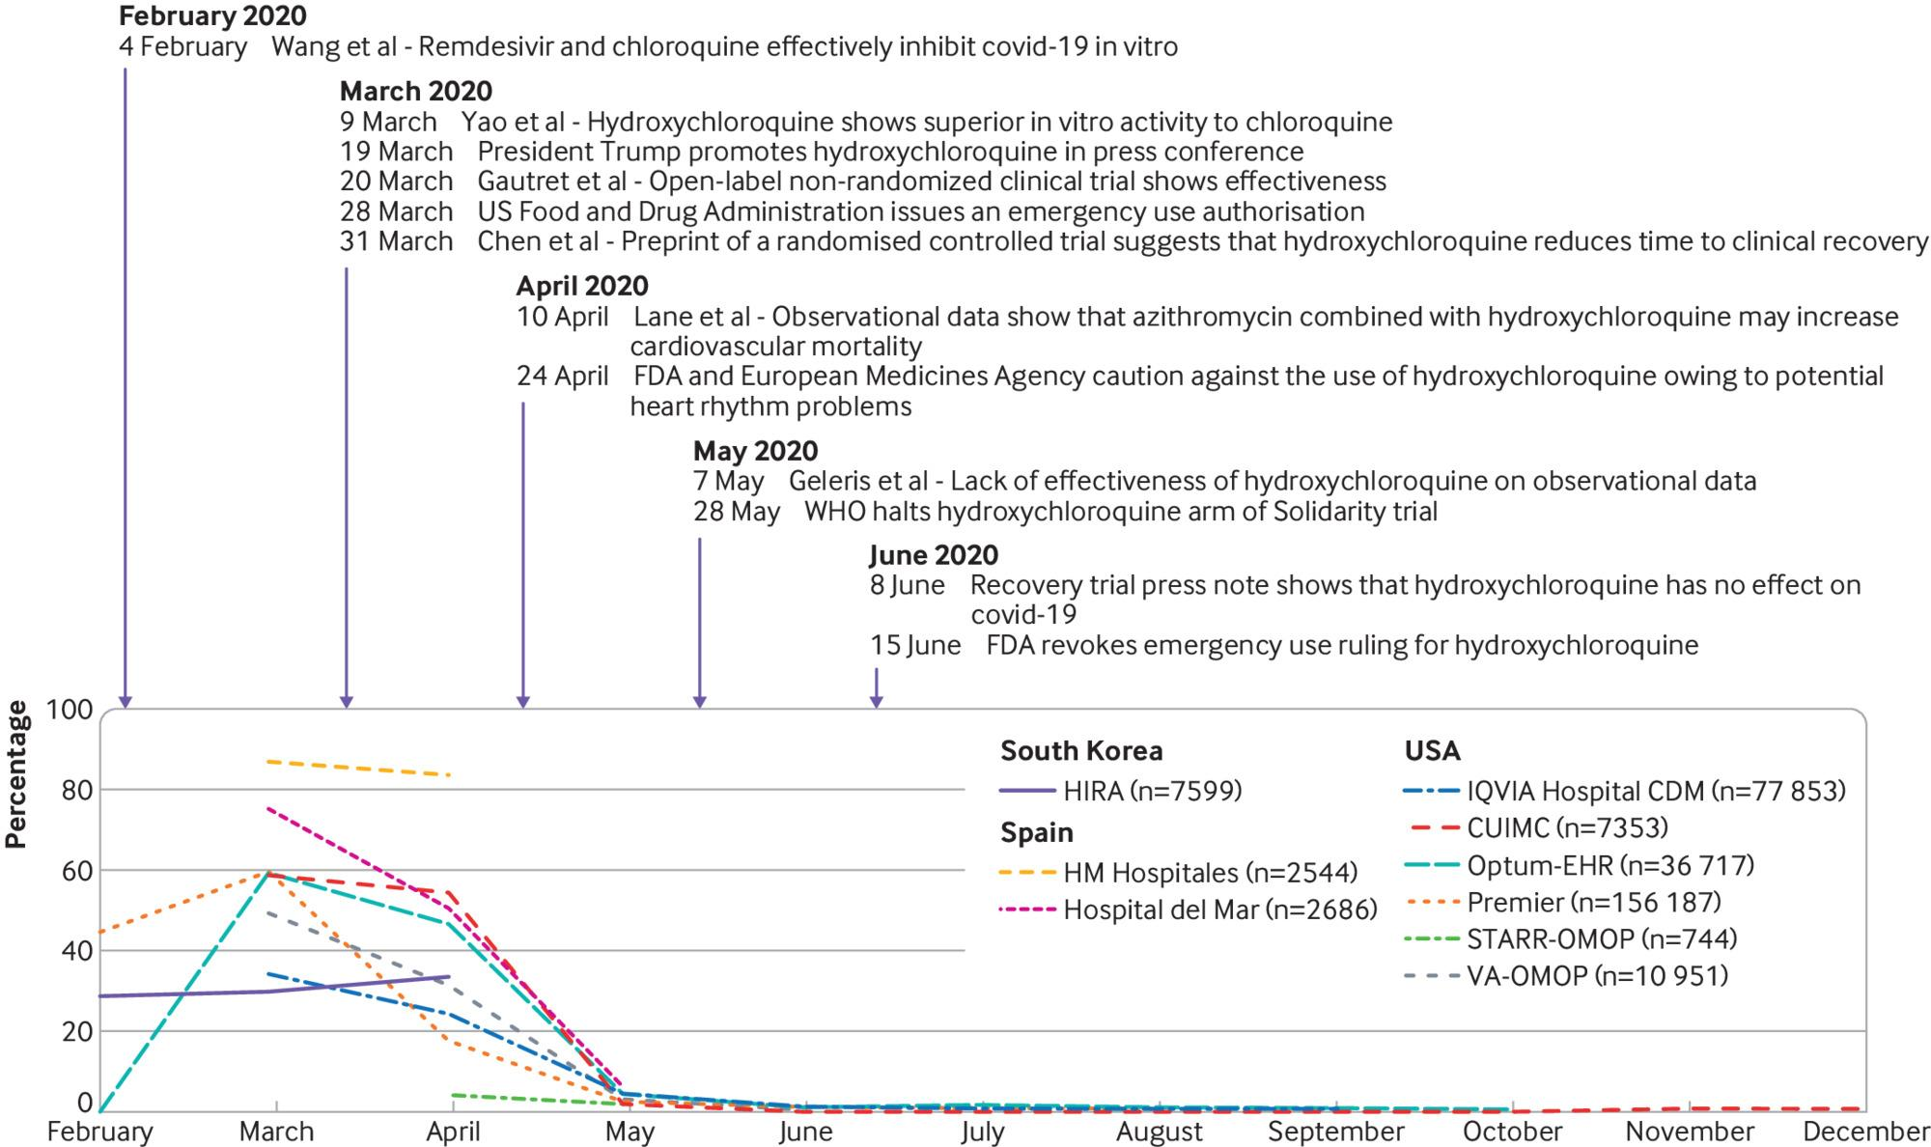
Impactful examples: Clinical characterization
[01] Real World Data at Scale
Time trends in hydroxychloroquine use
Prats-Uribe A, Sena A G, Lai L Y H, Ahmed W, Alghoul H, Alser O et al. Use of repurposed and adjuvant drugs in hospital patients with covid-19: multinational network cohort study BMJ 2021; 373 :n1038 doi:10.1136/bmj.n1038

Slide 22
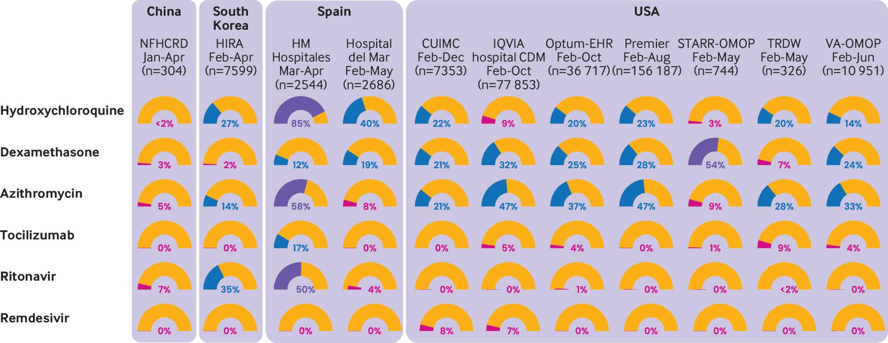
Impactful examples: Clinical characterization
[01] Real World Data at Scale
Prats-Uribe A, Sena A G, Lai L Y H, Ahmed W, Alghoul H, Alser O et al. Use of repurposed and adjuvant drugs in hospital patients with covid-19: multinational network cohort study BMJ 2021; 373 :n1038 doi:10.1136/bmj.n1038

Slide 23
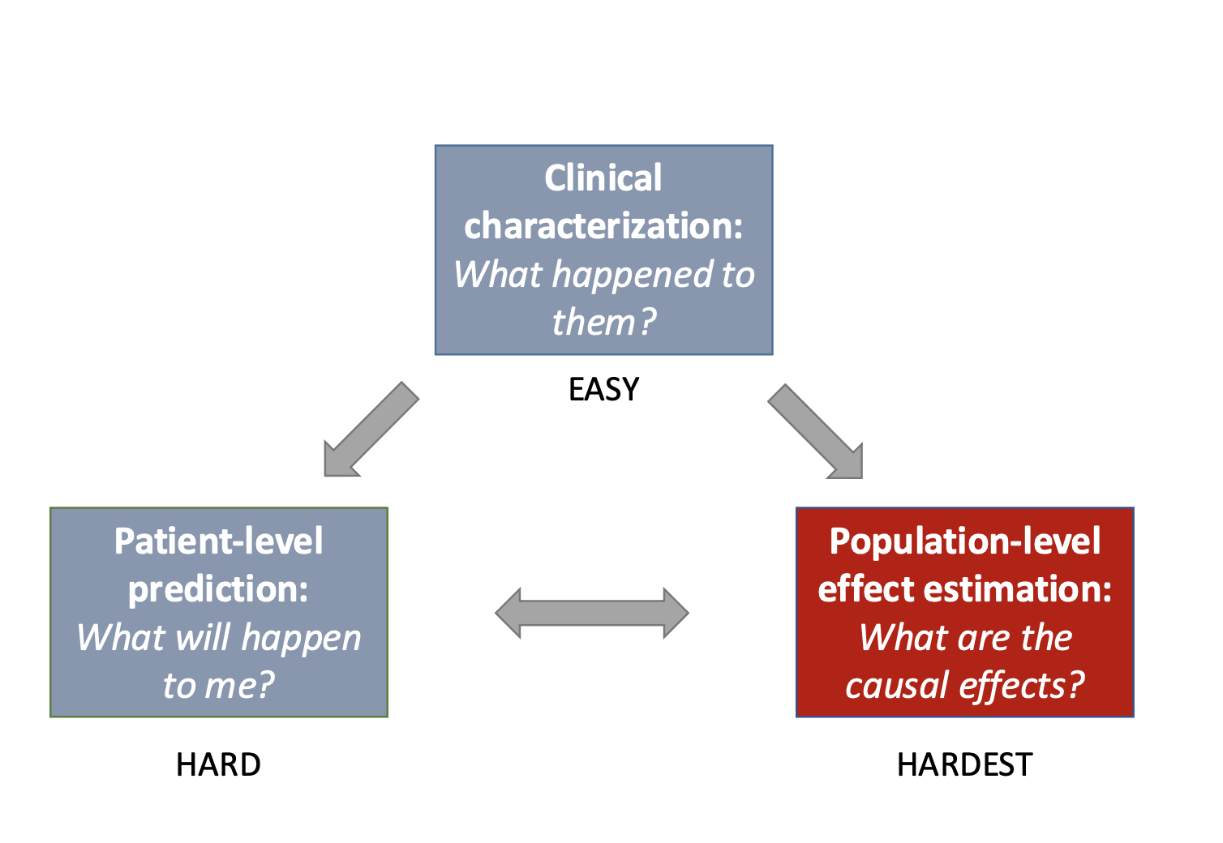
Impactful examples
[01] Real World Data at Scale

Slide 24
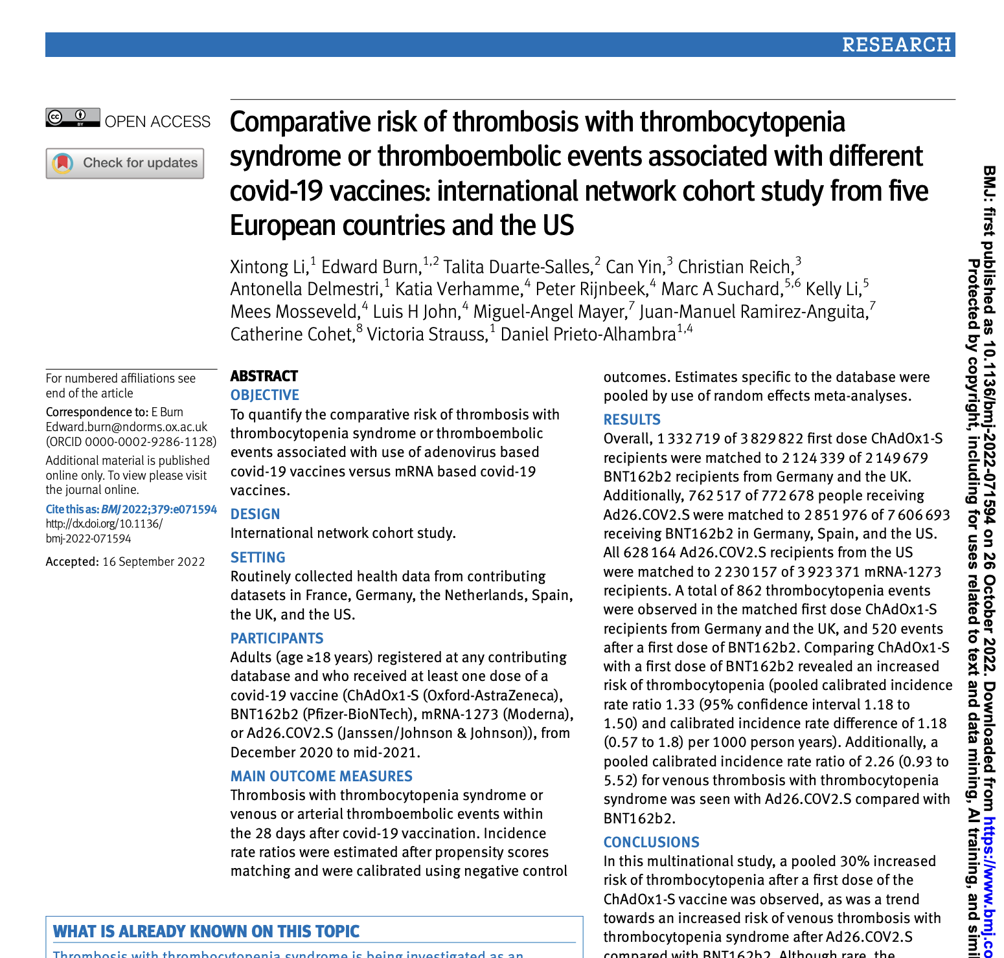
Impactful examples: Effect Estimation
[01] Real World Data at Scale
During first COVID19 vaccinations, need to evaluate safety at scale:
Showed 30% increased risk of thrombocytopenia following first dose ChAdOx1-S
Li X, Burn E, Duarte-Salles T, Yin C, Reich C, Delmestri A et al. Comparative risk of thrombosis with thrombocytopenia syndrome or thromboembolic events associated with different covid-19 vaccines: international network cohort study from five European countries and the US BMJ 2022; 379 :e071594 doi:10.1136/bmj-2022-071594

Slide 25
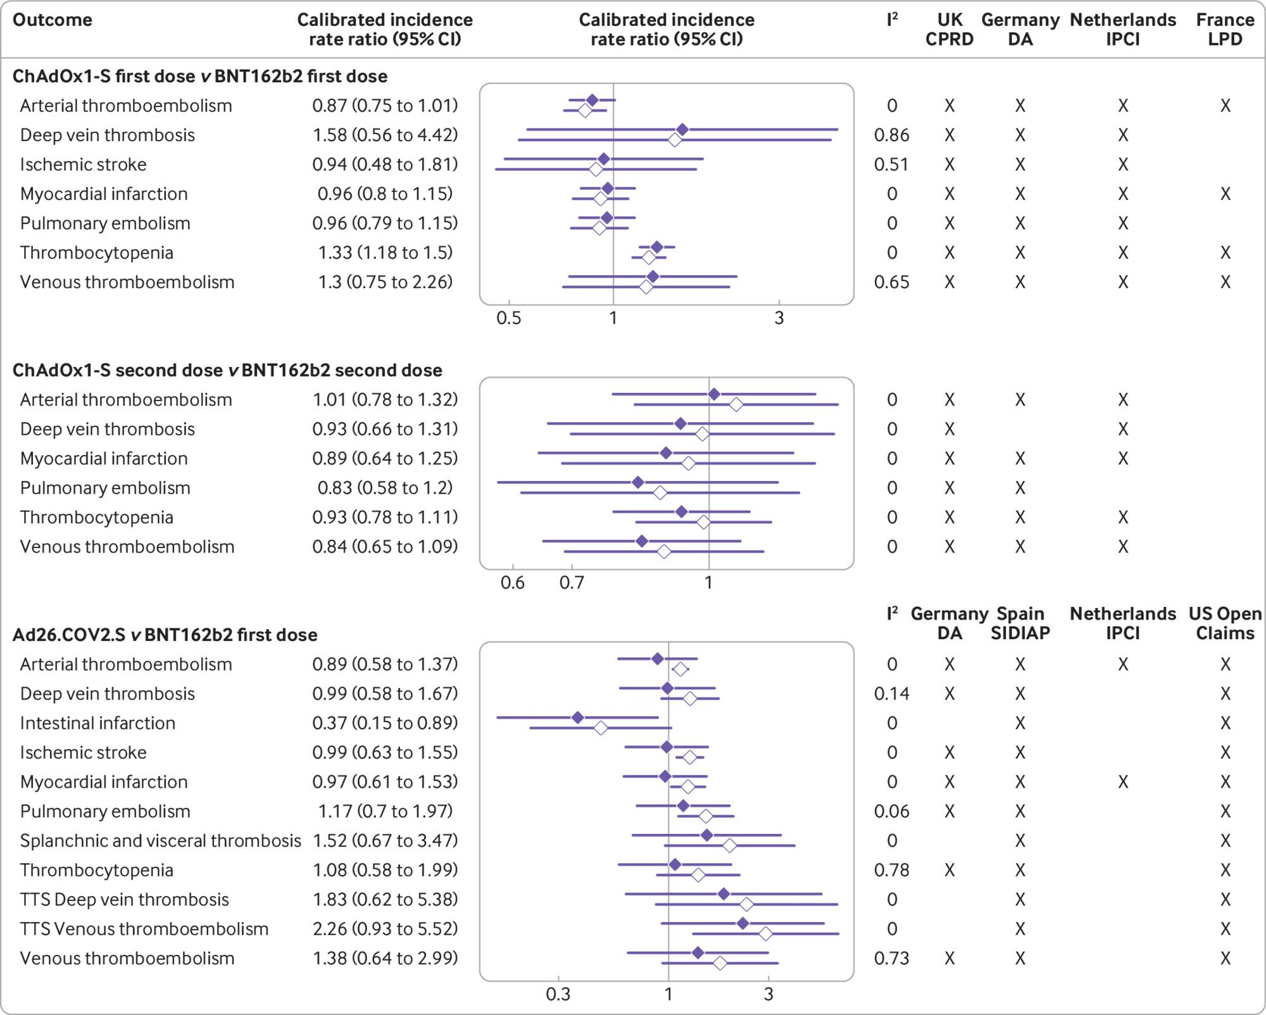
Impactful examples: Effect Estimation
[01] Real World Data at Scale
Li X, Burn E, Duarte-Salles T, Yin C, Reich C, Delmestri A et al. Comparative risk of thrombosis with thrombocytopenia syndrome or thromboembolic events associated with different covid-19 vaccines: international network cohort study from five European countries and the US BMJ 2022; 379 :e071594 doi:10.1136/bmj-2022-071594

Slide 26
Impactful examples: Effect Estimation
[01] Real World Data at Scale
Li X, Burn E, Duarte-Salles T, Yin C, Reich C, Delmestri A et al. Comparative risk of thrombosis with thrombocytopenia syndrome or thromboembolic events associated with different covid-19 vaccines: international network cohort study from five European countries and the US BMJ 2022; 379 :e071594 doi:10.1136/bmj-2022-071594

Slide 27
[03]
The Ecosystem

Slide 28
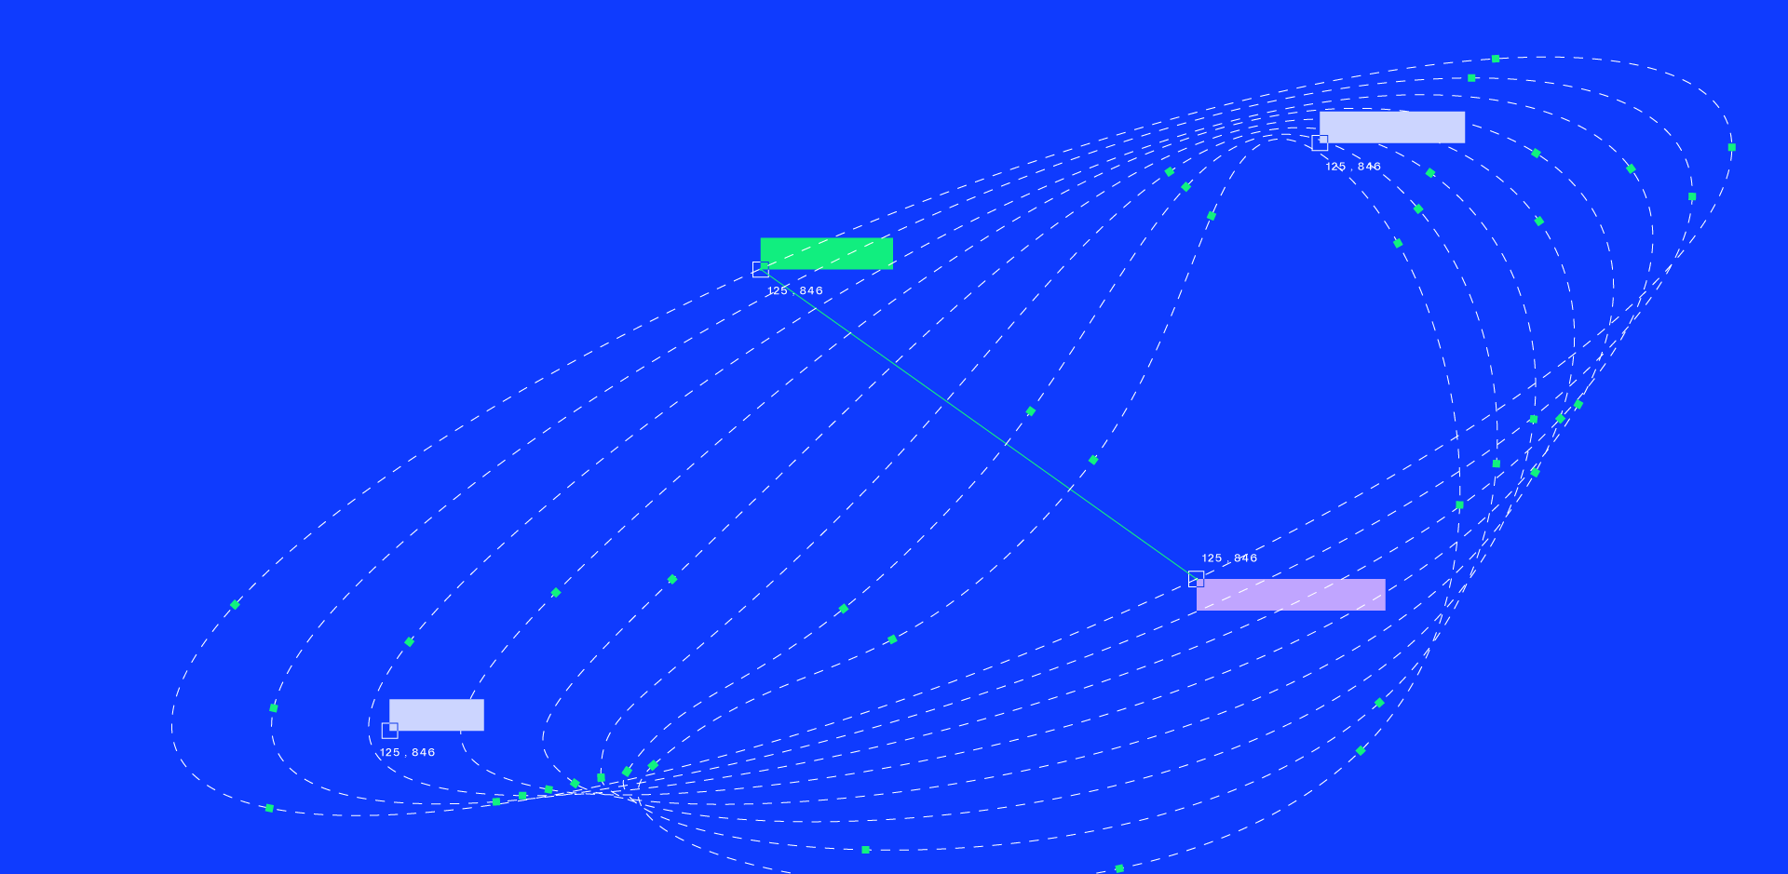

C/ de St. Antoni Maria Claret, 167, Sant Leopold Pavillion, 08025 — Barcelona
info@iomed.health
IOMED.HEALTH

